Slide 1



Building a Copilot-Powered BI Agent

Slide 2




Agenda
Business Problem
Identifying business challenges and inefficiencies that Agent is designed to solve.
Implementation Steps
A step-by-step guide to the initial setup and phased rollout process.
Component Integration
Technical architecture for connecting four components work together to provide better results
Best Practices
Critical guidelines for performance tuning and long-term maintenance.
Limitations
Transparency regarding system constraints and potential technical bottlenecks.
Roll Back Procedures
Contingency planning and recovery steps for deployment failures.
Next Phase
Future scalability and deeper integration with advanced Fabric IQ features.

Slide 3

The Evolution of Insights
From raw databases to AI-driven conversational business answers
Raw Data
Businesses started with unorganized information stored in legacy databases which was difficult to interpret.
Visual Dashboards
Tools like Microsoft Power BI and Tableau enabled users to visualize trends through reports.
AI Business Answers
Modern agents use natural language to deliver instant insights, eliminating the need to navigate complex charts.

Slide 4
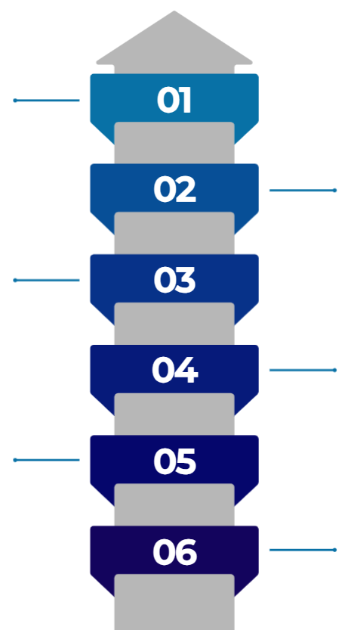
Implementation Roadmap
From semantic model construction to publishing the governed agent to stakeholder interfaces
Build & Optimize
Construct semantic model in Power BI Desktop and optimize via MCP Server in VS Code
Fabric Integration
Publish the semantic model to Fabric and connect it to the Fabric Data Agent
Agent Training
Train the agent with specific business definitions, guardrails, and instructions.
Orchestration
Connect the Data Agent into Copilot Studio for multi-agent management
Security Configuration
Enable enterprise security and Microsoft Entra ID protocols for governed access.
Global Deployment
Publish the final agent to Microsoft Teams to enable broad stakeholder access

Slide 5
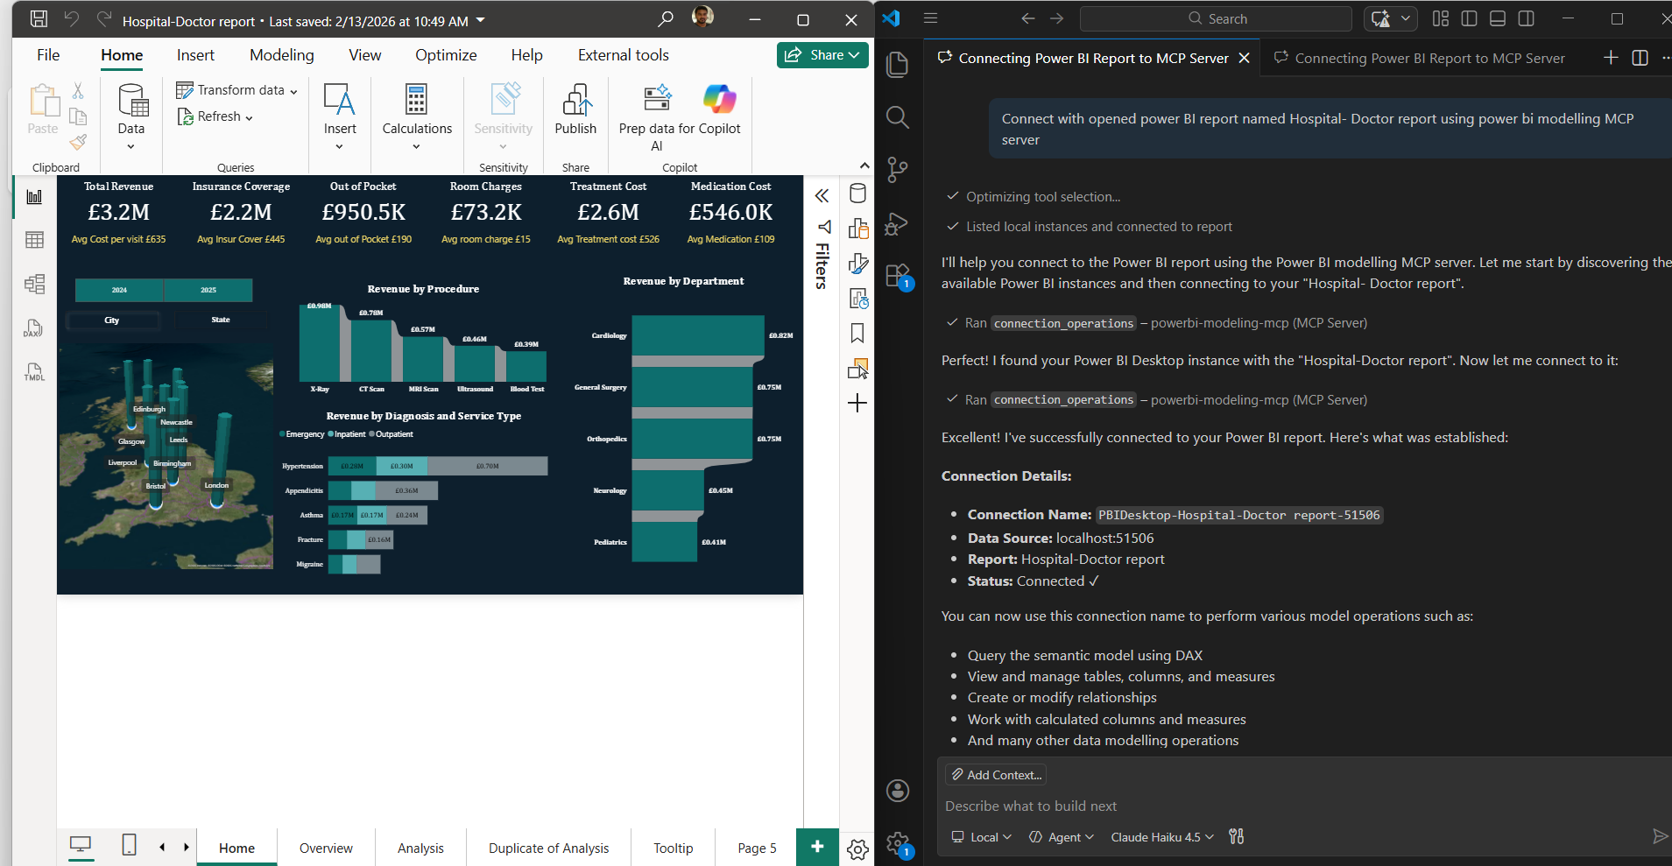
Modeling & MCP Breakdown
Technical optimization of the semantic model using MCP Server and VS Code integration
Power BI Desktop
Foundation for model creation utilizing data modeling best practices, measures, and visual layers.
MCP Server in VS Code
Model performance optimization and cardinality analysis.
Implementation of Row Level Security (RLS).
Enhanced relationship management and semantic modeling.

Slide 6
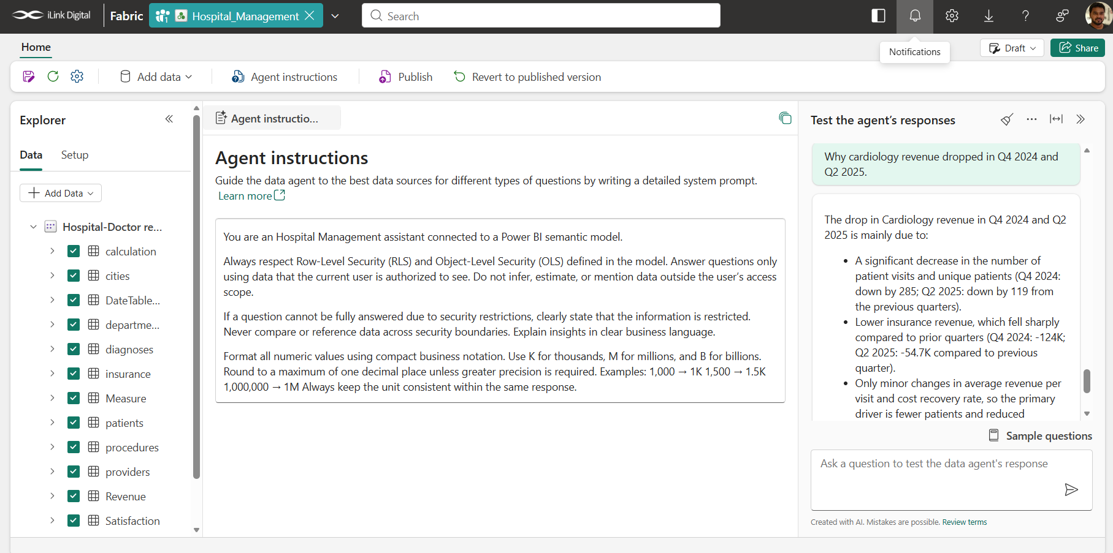
Agentic & Deployment Layer
Leveraging Fabric Data Agent
Fabric Data Agent
Context-aware reasoning and insight generation.
Alignment with complex business rules.
Built-in guardrails and specialized instructions.

Slide 7
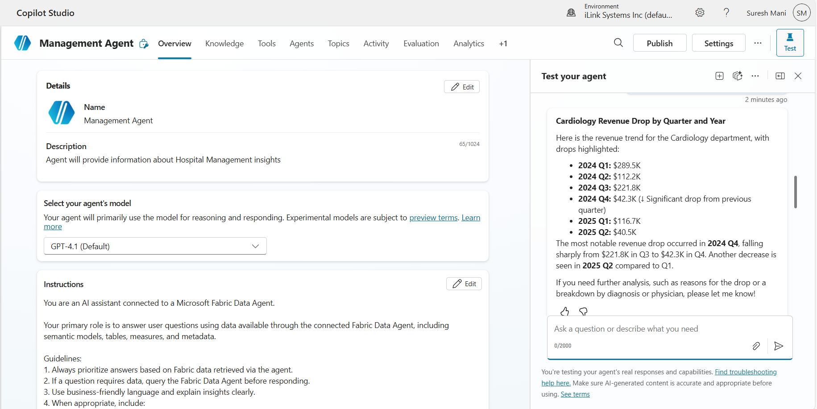
Agentic & Deployment Layer
Copilot Studio for multi-agent orchestration and enterprise governance
Copilot Studio
Manages agent creation, multi-agent orchestration, and deployment to Microsoft Teams with Entra ID integration

Slide 8
Multi Agent Orchestration
User Query
Parent Agent
Output
Agent 1
Agent 2
Agent 3

Slide 9

Real-World Use Case Scenario
Context-aware reasoning applied to a regional revenue drop in a Teams-based healthcare or retail environment. A stakeholder asks: Why did Cardiology revenue drop in Q3 ? The Agent understands context, applies RLS, analyzes the semantic model, explains drivers, and suggests drill-downs

Slide 10
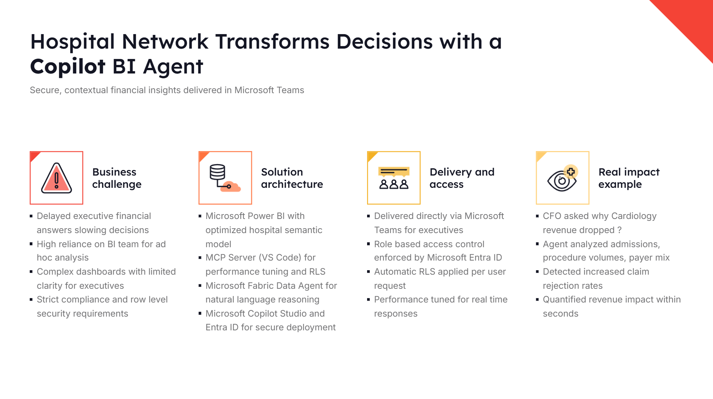
Hospital Network Transforms Decisions with a Copilot BI Agent
Secure, contextual financial insights delivered in Microsoft Teams
Business challenge
Solution architecture
Delivery and access
Real impact example
Delayed executive financial answers slowing decisions
High reliance on Bl team for ad hoc analysis
Complex dashboards with limited clarity for executives
Strict compliance and row level security requirements
Microsoft Power BI with optimized hospital semantic model
MCP Server (VS Code) for performance tuning and RLS
Microsoft Fabric Data Agent for natural language reasoning
Microsoft Copilot Studio and Entra ID for secure deployment
Delivered directly via Microsoft Teams for executives
Role based access control enforced by Microsoft Entra ID
Automatic RLS applied per user request
Performance tuned for real time responses
CFO asked why Cardiology revenue dropped?
Agent analyzed admissions, procedure volumes, payer mix
Detected increased claim rejection rates
Quantified revenue impact within seconds

Slide 11
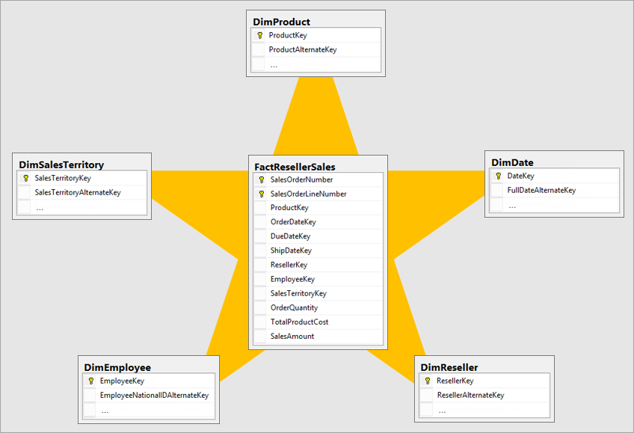
Semantic Model Recommendations for Agent
General
Keep the model clean by removing unnecessary rows, columns, and tables.
Structure dimension and fact tables effectively to support analysis.
Define accurate relationships with appropriate cardinality.
Implement role-based security to protect sensitive data.
Document the model comprehensively for easy reference.

Slide 12
General requirements - Copilot Powered BI Agent
Your administrator needs to enable Data Agent in Microsoft Fabric.
Microsoft Fabric Capacity (F SKU or above)
Your Fabric capacity needs to be in one of the regions listed in Fabric region availability.
Power BI Pro or Premium Per User (PPU).
Copilot Studio license
Access to Fabric Data Agent
Microsoft Teams access for end users
VS Code Installed
MCP Server configured

Slide 13

Limitations with Copilot powered BI Agent
Semantic Model Dependency:
  Agent perform based on Semantic model. AI does NOT fix bad data modeling
Natural Language Understanding Constraints:
  Even though it's conversational, Business slang not defined in metadata may return wrong insights
RLS & Security Complexity:
  Incorrect role mapping can expose or restrict data incorrectly.
  Security must be designed carefully before AI exposure.
Performance & Scale Constraints:
  High concurrent users in Teams can affect responsiveness.
  Complex DAX calculations increase query time.
Licensing & Cost Considerations:
  Costs can increase if: Fabric capacity is under-provisioned, User base scales.
Limited Custom Logic in Fabric Data Agent:
  Cannot fully customize the Agent like a pure Azure OpenAI solution.

Slide 14

Layered Rollback Procedures
Targeted recovery actions for Copilot, Fabric, and Core BI layers
Copilot Studio Layer
Unpublish agents or revert to stable versions in Microsoft Copilot Studio to stop conversational issues immediately.
Fabric Data Agent
Disconnect updated models and reconnect to the last validated version in Microsoft Fabric to maintain governed responses.
Semantic Model Layer
Restore previous versions in Power BI, revert DAX changes, and revalidate measures to protect reporting accuracy.
Security & RLS Layer
Re-assign Microsoft Entra ID groups and revert RLS mappings to prevent unauthorized data exposure during access issues.

